Slide 1
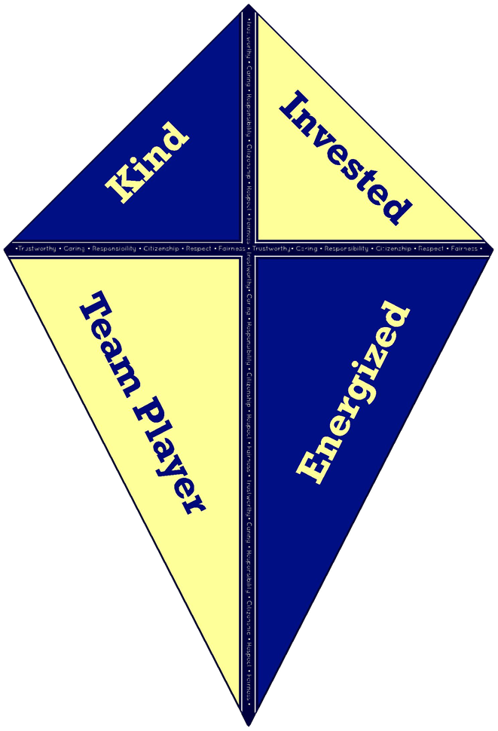
The KITE Philosophy
Franklin Academy’s Positive Behavior System

Slide 2
What is the KITE Philosophy?
The Kite Philosophy was developed to increase positivity at Franklin Academy and to recognize students that showcase the: Six traits of Character

Slide 3
How Does it Work?
Throughout the school year, you will have the opportunity to get Franklin shout-outs, and earn KITE Cash to purchase different items.
Teachers will be looking for positive behaviors (the 6 character traits) and will reward those students with KITE Cash.
Our Goal: Create a positive, safe learning environment for all.
How do you think this can be applied in our throughout the school?
What positive behaviors do you think teachers will be on the lookout for?

Slide 4
6 Traits and 4 Principles
Be Kind: This one means to do something thoughtful for another person. It can also mean sharing, being a good listener, or simply helping someone out.
Be Invested: That means putting in all of your effort in whatever you are doing. Always trying your best!
Be a Team Player: Being a team player means cooperating with your classmates, and working together. It also means to make sure that everyone feels safe and comfortable in our classroom, especially when sharing ideas.
Be Energized: This means being excited, communicative and willing to learn. It also means having a positive mindset everyday.

Slide 5
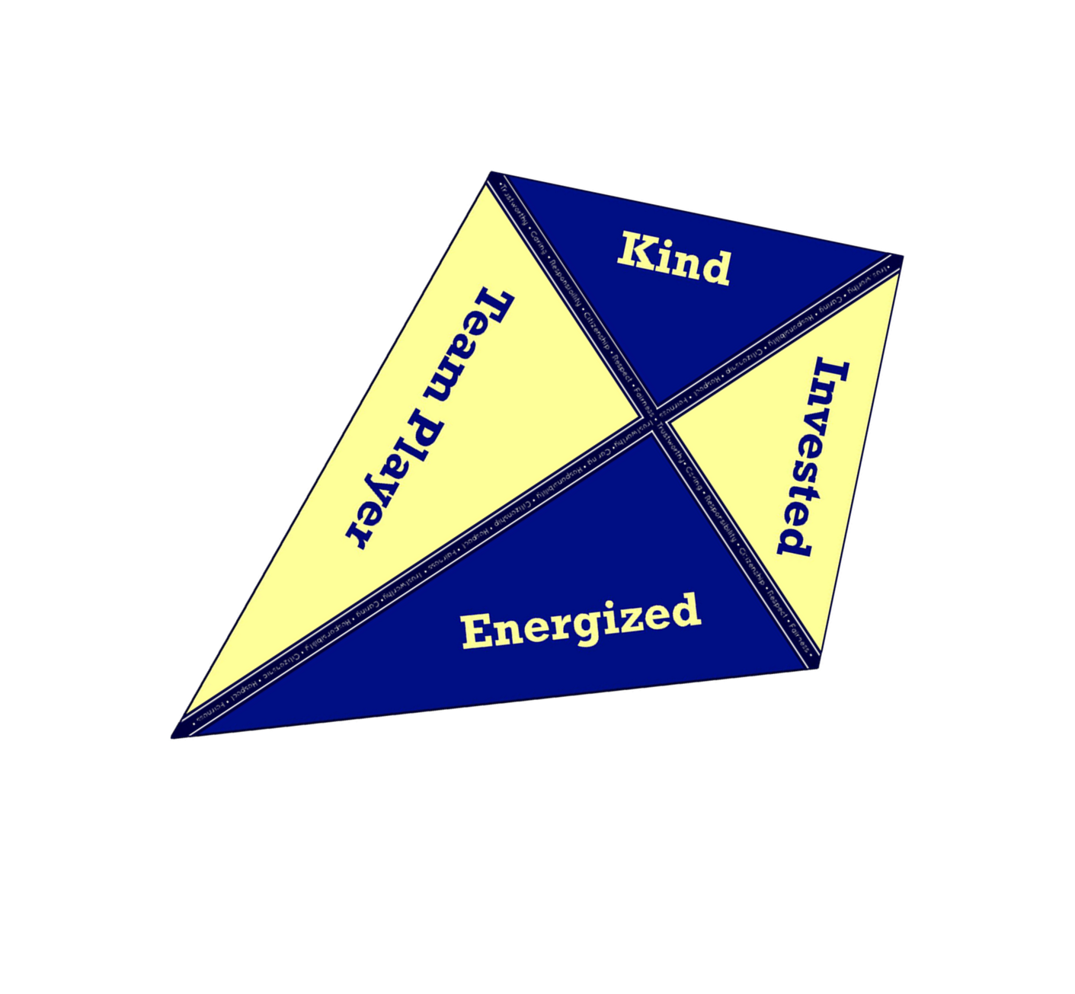
Time to Shop!
So you’ve earned some KITE Cash and you want to go shopping? Awesome! Every Friday morning in the cafeteria, you can spend your hard earned dollars at the KITE Cart!
You can either purchase items on the cart or other incentives such as:
Eating lunch outside
Club Lunch (you choose where you sit!)
Franklin Academy Apparel
Yearbooks
School Event Admission
And much, much more!

Slide 6
Break Out Groups
In small groups, brainstorm how you and your friends can earn KITE Cash. Each group will be assigned one of the 6 character pillars
Brainstorm on your own and write down all the specific ways that you can show your character trait
Discuss with your group
Create a sign to hang in the classroom that shows students how
they can be a person who exhibits this trait

